Slide 1
E-Voting System Using Blockchain
PREPARED BY :
Shyamendra Bhadauria
Divyansh Kathait
Sanskar Mittal
Shivank
PROJECT MENTOR
MS. VIDUSHI WANCHOO
( Assistant Professor)
Minor Project

Slide 2
TABLE OF CONTENTS
Motive
Problem Statement
Introduction
Brief Description
System actors and Features
Use Case Diagram
Conclusion

Slide 3
Motive
In every democracy, the security of an election is a matter of national security. The computer security field has for a decade studied the possibilities of electronic voting systems, with the goal of minimizing the cost of having a national election, while fulfilling and increasing the security conditions of an election .
Electronic voting machines have been viewed as flawed, by the security community, primarily based on physical security concerns. Anyone with physical access to such machine can sabotage the machine, thereby affecting all votes cast on the aforementioned machine. Finding a way to solve this issue.

Slide 4
Problem statement
The security is one of the major issues in the e-voting system.we have to develop a system that can handle these concerns. This can be potentially solved is through the technology of blockchain and integrating it into the voting system this way the security of the system can be increased drastically.

Slide 5
Introduction
The most crucial factor for a system like e-VOTE to be successful is to exhibit a Voting Protocol that can prevent opportunities for fraud or for sacrificing the voter's privacy
The Voting Protocol that will be designed and implemented for the e-VOTE system will implement Blockchain Technology.

Slide 6
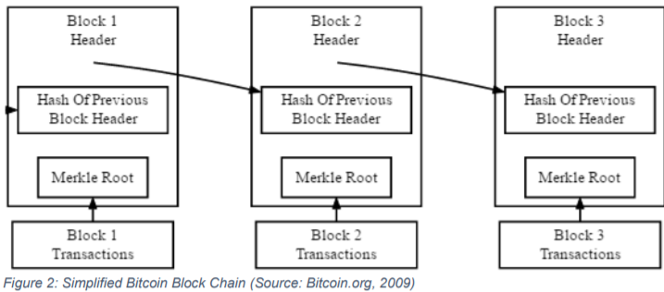
Brief Description
Blockchain :
Representation of Block formation in blockchain :-

Slide 7
A blockchain is a distributed, immutable, incontrovertible, public ledger. This new technology works through four main features :-
The ledger exists in many different locations: No single point of failure in the maintenance of the distributed ledger.
There is distributed control over who can append new transactions to the ledger.
Any proposed “new block” to the ledger must reference the previous version of the ledger, creating an immutable chain from where the blockchain gets its name, and thus preventing tampering with the integrity of previous entries.
A majority of the network nodes must reach a consensus before a proposed new block of entries becomes a permanent part of the ledger.
These technological features operate through advanced cryptography, providing a security level equal and/or greater than any previously known database.

Slide 8
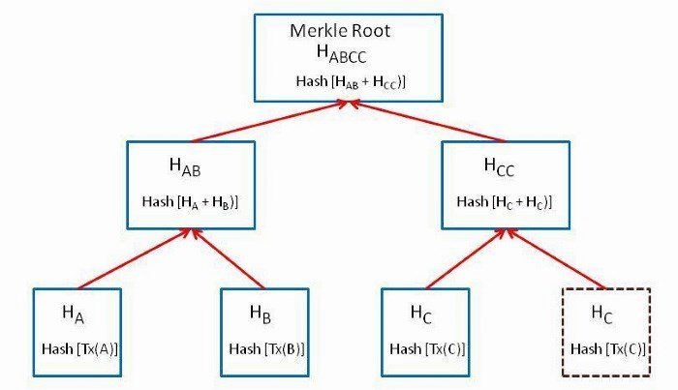
Merkle Root

Slide 9
System Actors and their Features
ADMIN
Admin Login.
Admin can Add/Modify Name of Parties.
Admin can Add Voter Name and assign Voter ID.
Admin can Delete Voter Name and Voter ID.
Voter
Registered Voter can login with valid Voter Name and Voter ID.
Registered Voter can vote only once.
Registered Voter is given choice to Vote for the Party of his choice.
Party of choice is confirmed.
Result
Party having maximum vote wins.
Winner Party name is displayed.

Slide 10
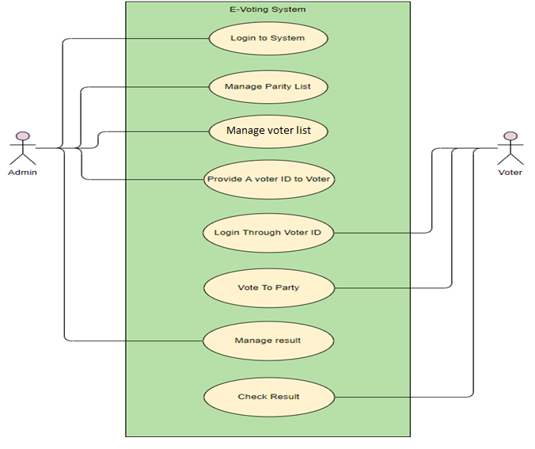
Use Case Diagram

Slide 11
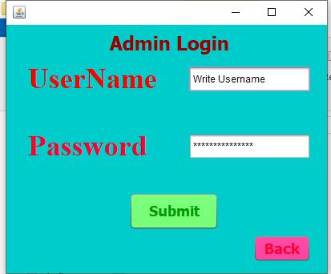
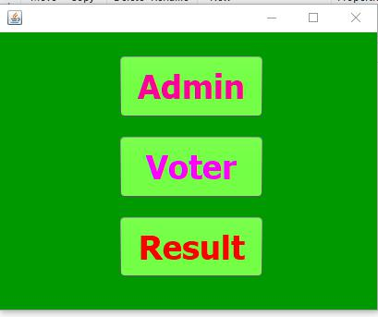
SNAPSHOTS
MAIN WINDOW ADMIN LOGIN WINDOW

Slide 12
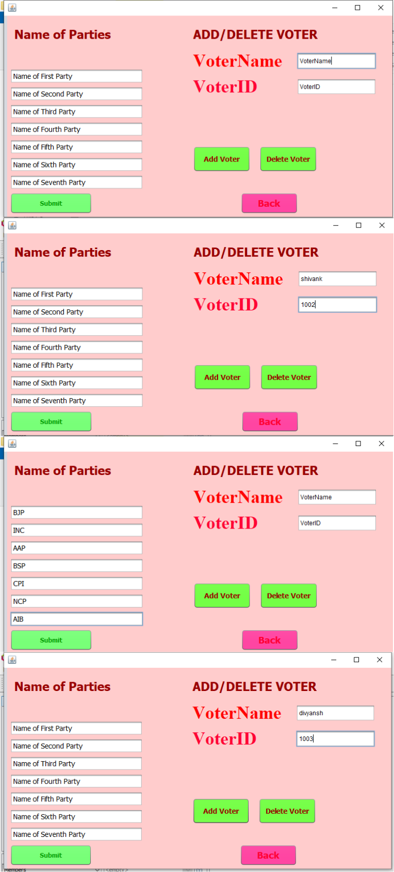
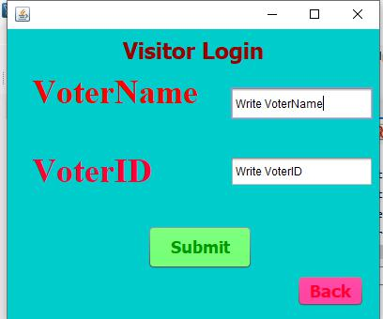
SNAPSHOTS
ADMIN WINDOW VOTER LOGIN WINDOW

Slide 13
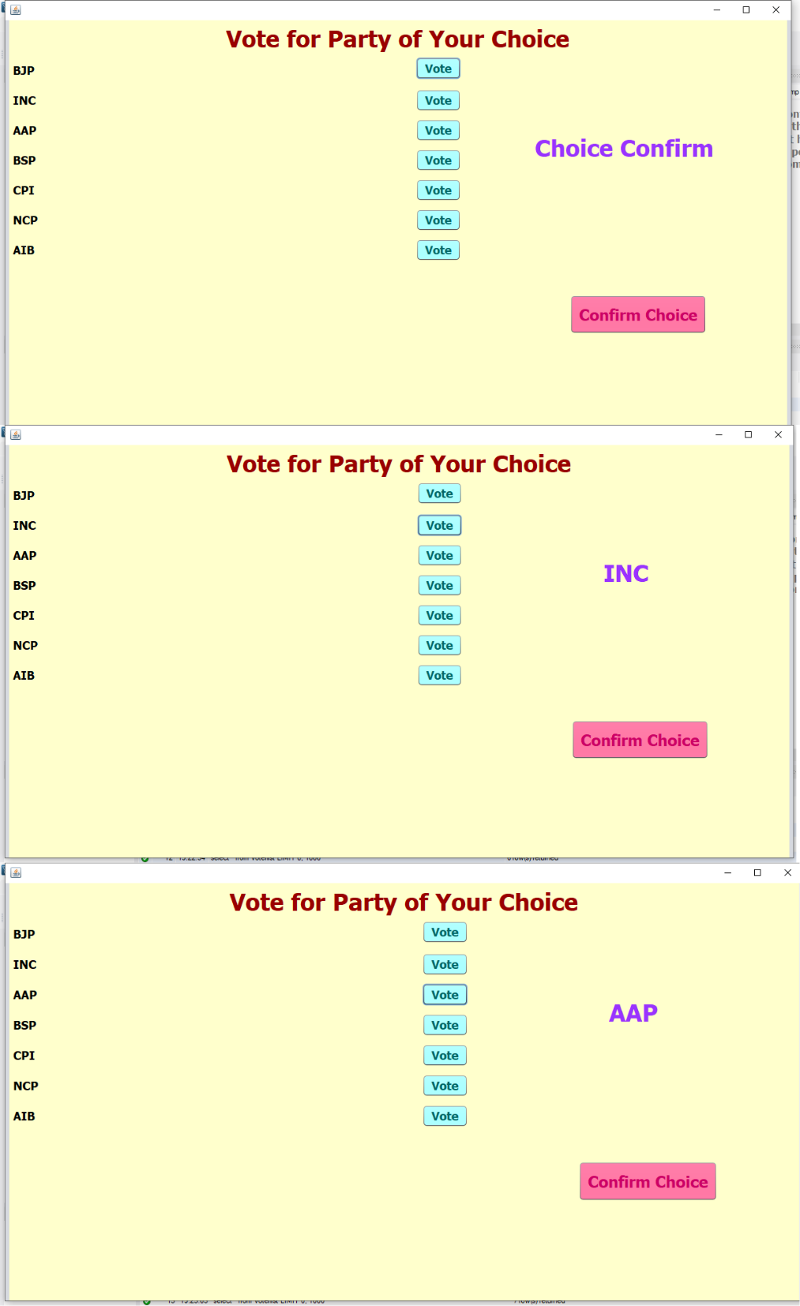
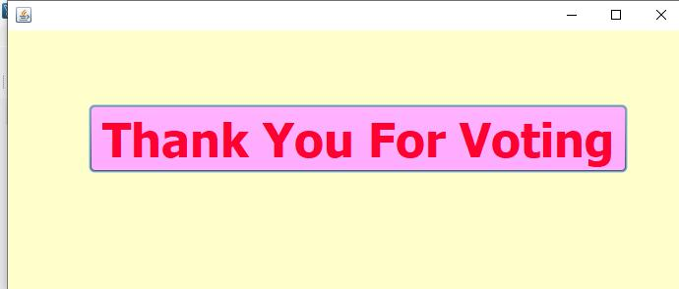
SNAPSHOTS
VOTE SUBMIT WINDOW THANK YOU WINDOW

Slide 14
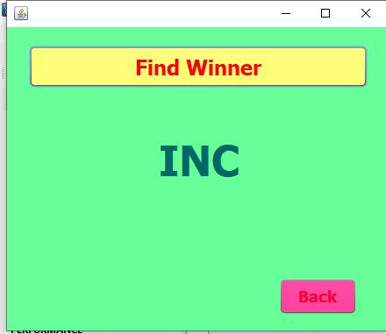
SNAPSHOTS
RESULT WINDOW

Slide 15
Conclusion
At present, our government is spending crores for conducting an election. This money is spent on issues such as security, electoral ballots etc. The average percentage of voting is less than 60 %. Moreover, voting fraud can be easily done in the present system. Also, the percentage of literates coming to vote is very less. But with our system, the money spent on the election can be reduced. Also, there is no chance of voter frauds and the money spent on security can be drastically decreased.

Slide 16
THANK YOU

